Slide 1
Plant Health Monitoring with Photos based on Deep Learning
Abdul-Azeez Olanlokun – Winter Semester 2022
Deep Learning
Electronic Engineering
February, 2023.

Slide 2
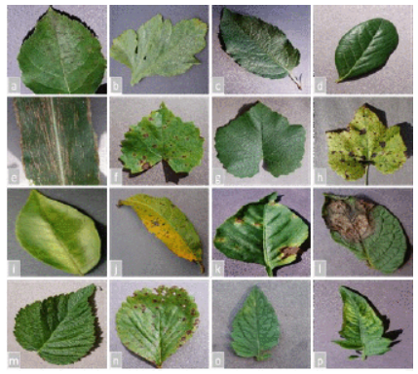
Motivation
Agriculture plays a major role in the world economy
Food
Plant Diseases
Deep Learning
(1)

Slide 3
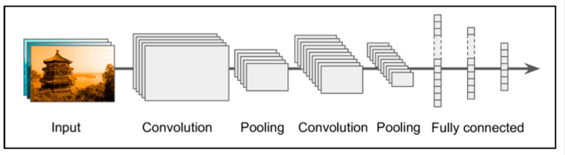
Introduction
What is Deep Learning?
Convolutional Neural Network(CNN)
(2)

Slide 4
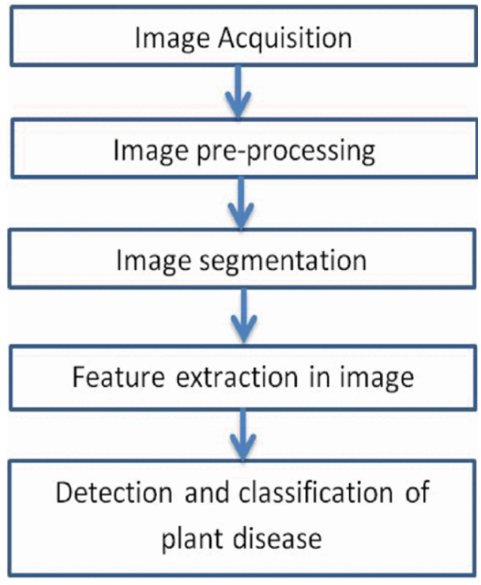
Image Processing
Some of the image processing steps are:
Image Acquisition
Image Pre-Processing
Image Segmentation
Feature Extraction in Image
Detection and Classification
(3)

Slide 5
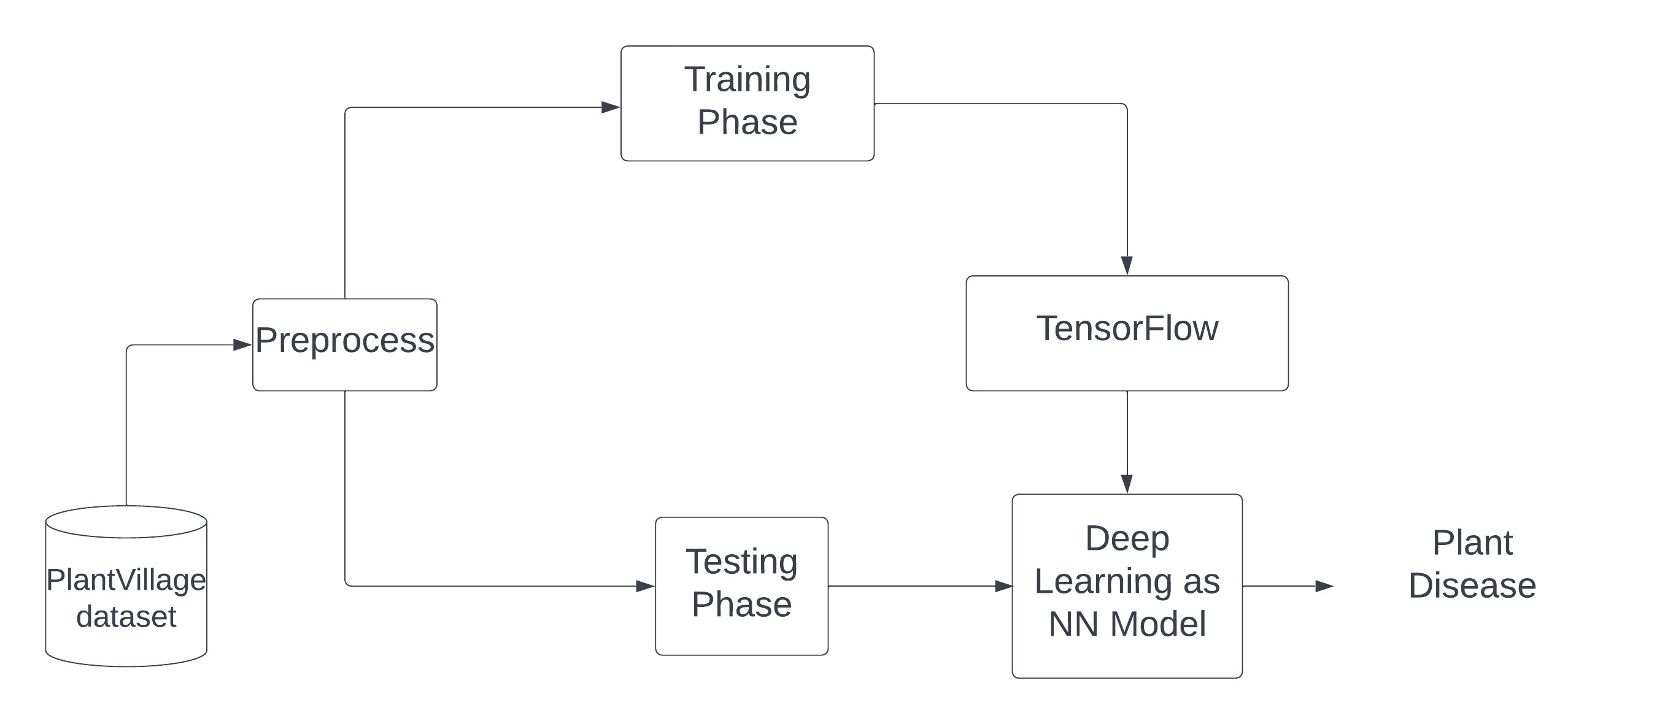
Implementation
Dataset Collection:
Plant Village Dataset from SP Mohanty’s GitHub repository.
80% of the dataset was used to train the model and 20% for testing.
System Overview

Slide 6
Implementation Results
In this study, a convolution neural network model is built.
Learning rate = 0.001 using AlexNet model.
The momentum = 0.9
Stochastic Gradient Descent (SGD) was used as the optimizer
10 epochs were used, and the batch size was set at 20.
A 20% sample of the photos from the Plant Village dataset were used to evaluate the model’s precision. 20% of the photos in each class were chosen at random for testing.
The testing dataset provides an accuracy of 90.0%.

Slide 7
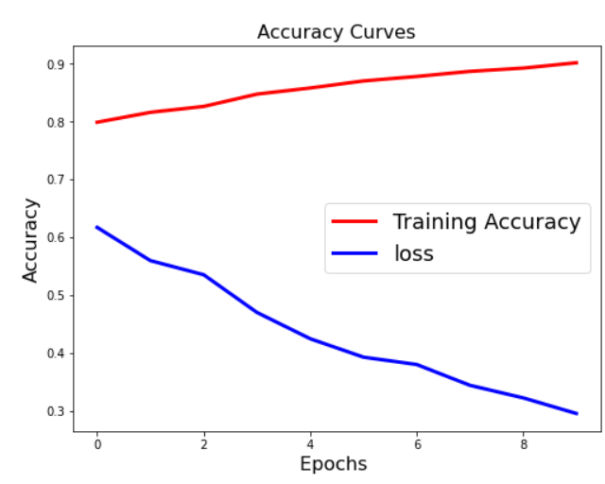
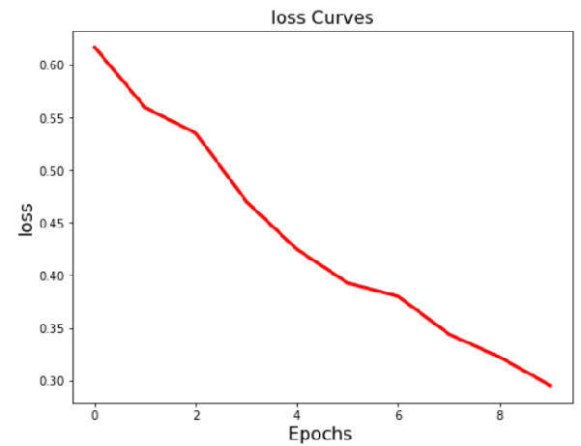
Implementation Graphs
Accuracy vs Epochs
Loss vs Epochs

Slide 8
Conclusion
One of the most significant areas of any world economy is agriculture. It is crucial to foresee crop diseases if you want to see your country’s economy grow. Using a CNN model, the suggested technique classifies the various plant diseases included in the Plant Village dataset.

Slide 9
References
SP Mohanty, DP Hughes and M Salathe, ”Using Deep Learning for Image- ’ Based Plant Disease Detection”, Frontiers in Plant Science,vol. 7, pp. 1-7, September 2016.
Ajit, A.; Acharya, K.; Samanta, A. A review of convolutional neural net_x0002_works. In Proceedings of the 2020 International Conference on Emerging Trends in Information Technology and Engineering (ic-ETITE), Vellore, India, 24–25 February 2020.
Al Hiary H, Bani Ahmad S, Reyalat M, Braik M and ALRahamnehZ, ”Fast and Accurate Detection and Classification of Plant Diseases”, International Journal of Computer Applications, vol. 17, no. 1, pp. 31-38, 2011.

Slide 10
Discussion and Questions?

